Slide 1
ITV SETUP DATA SCIENCE CHALLENGE
BY: KAZEEM ENITAN BELLO
MSc. STUDENT, ARTIFICIAL INTELLIGENCE AND DATA SCIENCE
UNIVERSITY OF HULL, UK

Slide 2
THE CHALLENGE
Create a model using the data to predict how likely it is that a user will watch the ITVX exclusive series “A Spy Among Friends"

Slide 3
Brief Introduction of The Series
The series is about based on the events that occurred when the Russian infiltrated the British Army during the Nazi era

Slide 4
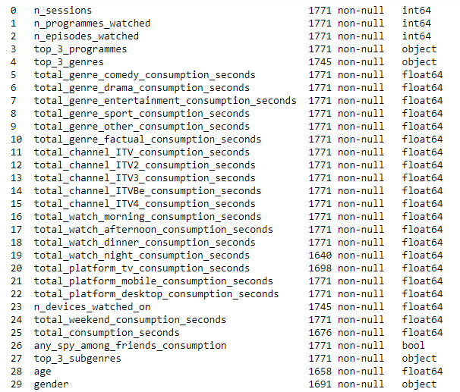
The Data
The data collected about each users contains
the above features

Slide 5
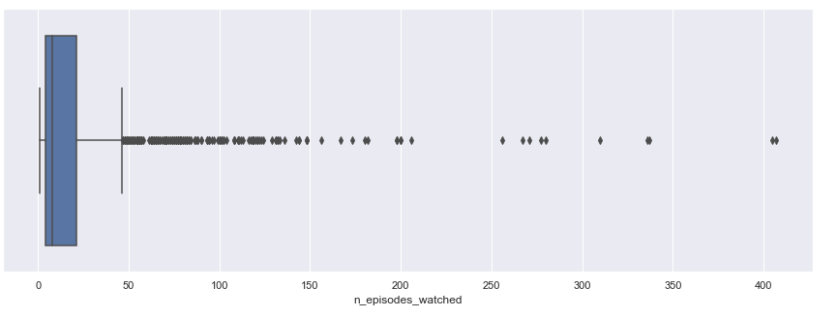
The Analysis
After the analysis using python, the following insight can be drawn from the data
Most of the users watched about 50 episodes

Slide 6
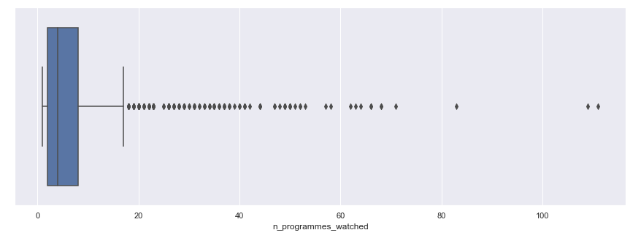
The Analysis
After the analysis using python, the following insight can be drawn from the data
Most of the users watched about 20 different programmes

Slide 7
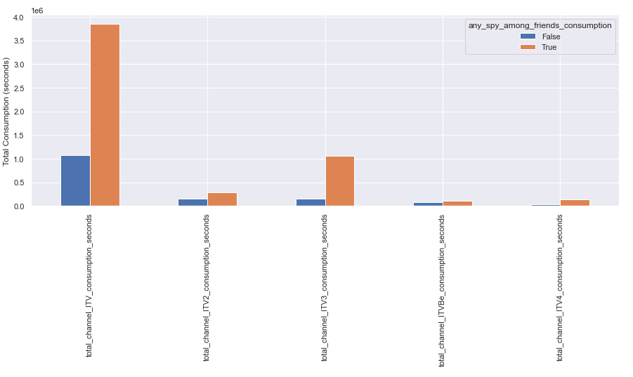
The Analysis
After the analysis using python, the following insight can be drawn from the data
ITV channel is the most watched channel

Slide 8
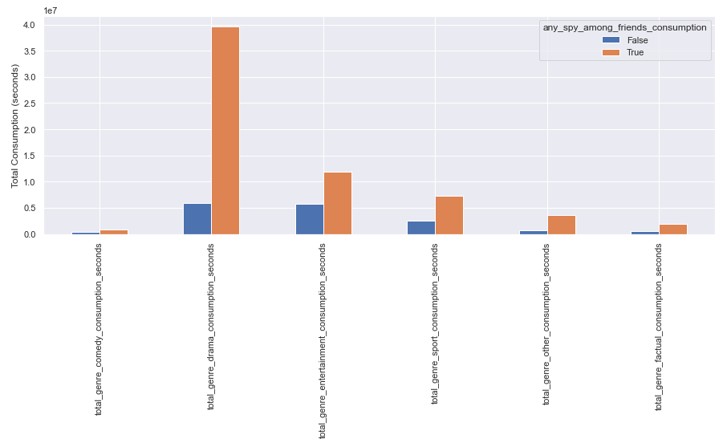
The Analysis
After the analysis using python, the following insight can be drawn from the data
Drama genre is the most watched genre

Slide 9
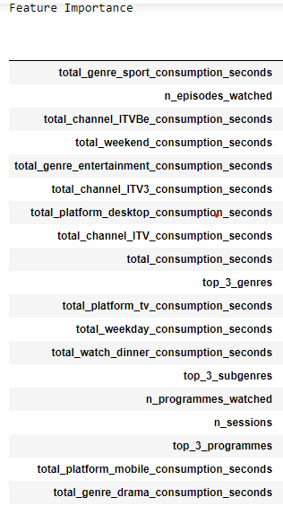
The Model
According to the feature importance of the model, the following features are the most important in the prediction

Slide 10
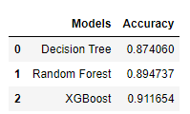
The Model
XGBoost Classifier performs best in the prediction

Slide 11
The Model
Predicted Label
True
False
264
37
True
267
34
True Label
276
25
28
203
False
28
203
22
209
Decision Tree Classifier
Random Forest Classifier
XGBoost Classifier

